Slide 1
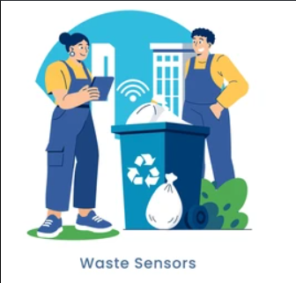
FIELD PROJECT — WASTE MANAGEMENT
SMART DUSTBIN AI-Enabled Fill-Level Monitoring
A field study on public waste overflow, and a low-cost sensor-based fix that alerts collection teams before a bin overflows.
PRESENTED BY Lavanya A · 25105116 · CSE
SITE VISITED Goundanur, Coimbatore
🚮 Be smart, use smart dustbins.
01 / 10

Slide 2

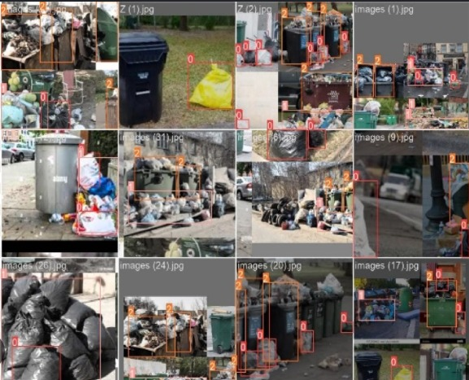
WHAT WE WENT TO SEE
Field Observation
Caption: overflowing bins, field visit
Reference: object-detection samples reviewed
QUICK NOTES FROM THE VISIT
• Bin overflows by midday near the entrance • No wet/dry segregation on site • One collection round a day, before peak demand
SMART DUSTBIN — FIELD PROJECT
02 / 10

Slide 3
THE PROBLEM — VERBATIM
“Public dustbins across our site overflow well before the next scheduled collection — spilling waste onto streets, drawing pests, and putting residents' health at risk, because collection runs on a fixed schedule, not the bin's actual fill level.”
[ Replace with your own field-verified problem statement — keep it one slide, one statement. ]
03 / 10

Slide 4
WHAT WE SET OUT TO DO
Objectives
Detect bin fill level in real time
Alert staff once a bin hits 80%
1
2
Cut overflow incidents by a set target
Shrink alert-to-pickup response time
3
4
Log peak-fill hours per bin location
5
Each objective is measurable — see speaker notes for targets.
SMART DUSTBIN — FIELD PROJECT
04 / 10
Notes:
Objectives, each with a verb and a target so progress is checkable: 1) Detect fill level in real time — ultrasonic sensor reading updated every 30 seconds, accurate to about ±2 cm. 2) Alert staff at 80% capacity — push notification / SMS to the collection team's phone. 3) Cut overflow incidents at the site by 50% within the pilot window, measured against the two-week baseline count. 4) Reduce average response time from alert to pickup to under 2 hours, down from a same-day-or-later baseline. 5) Log fill-level data continuously to identify each bin's peak-demand hours, so routes can eventually be planned around real demand rather than a fixed schedule.

Slide 5
WHY IT'S HAPPENING
Problem Analysis
WHY 1
Bins overflow before collection
3.2 hrs/day
↓
WHY 2
Collection runs once a day, fixed
avg. time a bin stays overflowing
↓
WHY 3
Schedule ignores actual fill level
68%
↓
WHY 4
No visibility into current level
of surveyed bins overflow pre-collection
↓
ROOT CAUSE
No real-time monitoring in place
1×/day
fixed collection frequency, site-wide
[ sample figures — swap in your own survey numbers ]
Residents
Municipal Corp.
Sanitation Workers
Shop Owners
05 / 10
Notes:
Five Whys trace the overflow back to its root cause: bins overflow because collection is fixed at once a day; that schedule was set without accounting for how fast different bins actually fill; nobody has visibility into current fill level between rounds; and ultimately there is no real-time monitoring system in place at all — that's the gap the project addresses. The three stat callouts (average overflow duration, share of bins overflowing pre-collection, and fixed collection frequency) are illustrative placeholders — replace with numbers from your own site survey. Stakeholders affected: residents living nearby, the municipal corporation that runs collection, the sanitation workers on the ground, and shop owners near the bin.

Slide 6
WHAT'S ALREADY TRIED
Existing Solutions & the Gap
Approach | Tried today | Where it falls short
Fixed-schedule collection | Trucks visit at set times daily | Ignores real fill level — over- or under-visits
Manual inspection rounds | Staff physically check each bin | Labour-heavy, infrequent, easy to miss
Public complaint reporting | Residents call or report overflow | Reactive only — action lags the mess
THE OPENING
No low-cost system gives real-time, automatic visibility into fill level — that's the gap a simple sensor-and-alert loop can close.
SMART DUSTBIN — FIELD PROJECT
06 / 10

Slide 7

THE SHORTLISTED IDEA
Smart Dustbin: Fill Sensing + Vision-Based Overflow Detection
AI / SENSING TECHNIQUE
WHY THIS COMBINATION
An ultrasonic sensor tracks fill %. A camera + object-detection model (trained on labelled overflow images) visually confirms spillage around the bin.
Cheaper than a camera-only rig
Works in low light too
Vision model verifies the alert
HARDWARE
Ultrasonic · Camera · ESP32 · Wi-Fi/GSM
TRAINING DATA
The object-detection model is trained on labelled photos of overflowing bins — bounding boxes mark bin and spillage regions so it learns to flag overflow on sight, not just by fill height.
07 / 10
Notes:
Two signals work together: the ultrasonic sensor gives a continuous fill percentage, while a lightweight object-detection model (trained on the labelled dataset shown — bounding boxes around bins and spilled waste) visually confirms an actual overflow, cutting false alarms from a sensor misread. Runner-up considered was a camera-only system with no distance sensor: this combination is cheaper than a full vision rig, keeps working in poor lighting via the ultrasonic reading, and the vision model adds a second layer of confidence before an alert fires.

Slide 8
HOW THE PIECES CONNECT
System Architecture
01
02
03
04
Data Source
Processing
Communication
Interface
→
→
→
Ultrasonic sensor in bin lid
Microcontroller computes % full
Wi-Fi/GSM sends the alert
Dashboard + SMS to staff
Bin serviced → level resets → monitoring continues
SMART DUSTBIN — FIELD PROJECT
08 / 10
Notes:
Walk through left to right: the ultrasonic sensor in the bin's lid takes a distance reading; the microcontroller converts that into a fill percentage; once the threshold is crossed, a Wi-Fi or GSM module sends the alert out; the collection dashboard (and an SMS to the field team) is where staff actually see and act on it. The dashed line underneath is the feedback loop — once the bin is emptied, the sensor's next reading resets the level and the cycle continues automatically, no manual reset needed.

Slide 9
WHAT SUCCESS LOOKS LIKE
Expected Outcomes
 | Before | After
Collection trigger | Fixed schedule | Real fill level (80% mark)
Overflow incidents | Frequent, unpredictable | Target: cut by half
Response time | Same day or later | Under 2 hours from alert
Visibility | None between rounds | Live, continuous fill data
FEASIBILITY
Low-cost parts, pilot-ready in weeks
COST
[ ₹ estimate per unit — fill in ]
RISK & MITIGATION
Sensor fouling → protective housing + cleaning schedule
SMART DUSTBIN — FIELD PROJECT
09 / 10
Notes:
Before/after framing: today collection is triggered purely by a fixed schedule with no visibility between rounds; after deployment, the trigger becomes the bin's actual fill level, response time to an alert should fall to under two hours, and overflow incidents are targeted to drop by half over the pilot. Feasibility is high — the hardware list is short and low-cost, and a pilot could be running within a few weeks. Cost is a placeholder for your own unit-cost estimate. Key risk: the ultrasonic sensor can get fouled by waste dust or splashes — mitigated with a simple protective housing and a periodic cleaning schedule for the sensor face.

Slide 10
WRAPPING UP
Conclusion & Learning
A fixed collection schedule can't see what a sensor can. Even a simple ultrasonic-and-alert loop closes the visibility gap this field study surfaced — and gives the site a cleaner, healthier public space with existing low-cost hardware.
AI USAGE DECLARATION
AI assistance was used for research support, slide drafting, and diagram layout. All content was reviewed, fact-checked, and edited by hand before submission.
LEARNING OUTCOMES
Turned a field problem into a spec
Sized a fix to fit the budget
🌿 Don't be mean, keep it clean.
Learned to argue a design choice
🚮 Be smart, use smart dustbins.
TOOLS USED
Arduino/ESP32 · Ultrasonic sensor · [Design tool] · [AI tool]
10 / 10
Notes:
Close by tying the conclusion back to the opening problem: a fixed schedule can't see what's actually happening inside a bin, and the sensor-based loop directly closes that gap. Learning outcomes to speak to: how the team translated a fuzzy field problem into a measurable technical spec, how they sized the solution to a realistic budget rather than over-engineering it, and how they learned to defend a design choice (ultrasonic vs. camera) with evidence. Name the actual tools your team used to build the slides and any prototype. The AI usage declaration should be edited to reflect exactly what assistance was used, per the assignment's honesty requirement.

